Slide 1


Hybrid Decentralization for Multi-Robot Orienteering with Mothership-Passenger Systems
Nathan L. Butler and Geoffrey A. Hollinger
Robotics Program, School of Mechanical, Industrial, and Manufacturing Engineering
Oregon State University
NSF Award No.
2322055

Slide 2
In this work, we leverage a hybrid centralized-distributed network available in robotic Mothership-Passenger systems to solve complex orienteering problems.

Slide 3
Ice Shelf
We motivate our work with an underwater multi-robot system designed to explore polar ice shelves.
Mothership

Slide 4
We consider this reduced network topology
Mothership

Slide 5
Centralized Topology
Mothership
The Mothership may be thought of as a centralized controller, capable of sending commands to each Passenger

Slide 6
Distributed Topology
Mothership
The Passengers may be considered as a distributed network, capable of sharing information between themselves and the Mothership

Slide 7
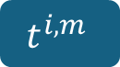

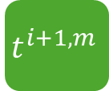


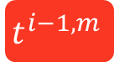
Hybrid Rescheduling
Mothership
We introduce the hybrid tour scheduling algorithm for Passenger orienteering.
$$t^{i−1, m}$$
$$t^{i, m}$$
$$t^{i+1, m}$$
Passenger i
$$t^{i, m}$$
SOP Solver
(MCTS)
$$T^{i}$$
Mothership
Task Data
Task Data
Neighboring Passengers
STOP & SOP Solver
(Sim-BRVNS)
UpdateScheduleDists
$$θ^{i}$$

Slide 8
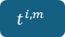

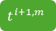

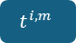
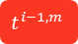
Hybrid Rescheduling
Mothership
The algorithm exchanges scheduling information between Passengers and the Mothership to create new tours as follows.
$$t^{i−1, m}$$
$$t^{i, m}$$
$$t^{i+1, m}$$
Passenger i
$$t^{i, m}$$
SOP Solver
(MCTS)
$$T^{i}$$
Mothership
STOP & SOP Solver
(Sim-BRVNS)
Task Data
UpdateScheduleDists
Task Data
Neighboring Passengers
$$θ^{i}$$

Slide 9
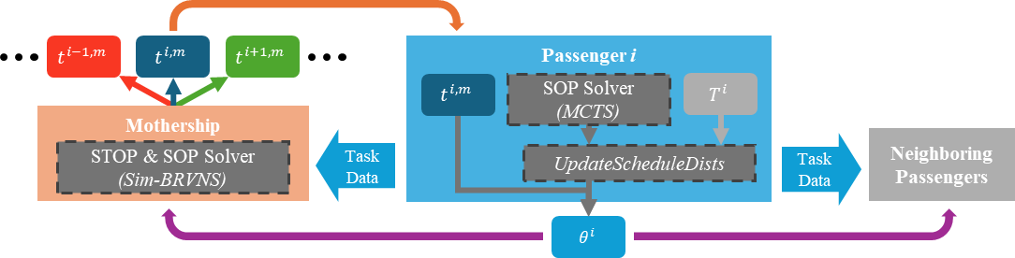
Hybrid Rescheduling
Mothership
Request new schedule from Mothership
A Passenger attempts to request a new tour plan from the Mothership

Slide 10
Hybrid Rescheduling
Mothership
Request new schedule from Mothership
If Message Received:
The Mothership uses a powerful onboard solver and leverages information it has aggregated to develop a new tour.
Mothership creates schedule with Sim-BRVNS solver

Slide 11
Hybrid Rescheduling
Mothership
Request new schedule from Mothership
If Message Received:
The Mothership attempts to return the new tour to the Passenger
Mothership creates schedule with Sim-BRVNS solver
Mothership sends new schedule to Passenger

Slide 12
Hybrid Rescheduling
Mothership
Request new schedule from Mothership
If Message Received:
Mothership creates schedule with Sim-BRVNS solver
If received, the Passenger begins to execute the new tour and communicates its new plan to neighboring robots.
Mothership sends new schedule to Passenger
If Message Received:
Begin executing new schedule, share updated schedule distribution

Slide 13
Hybrid Rescheduling
Mothership
If no schedule from Mothership:
Solve set of local schedules with MCTS
Otherwise, the Passenger uses a local solver to create a set of possible tours given locally-available information.

Slide 14
Hybrid Rescheduling
Mothership
If no schedule from Mothership:
Solve set of local schedules with MCTS
Evaluate MCTS solutions and stored schedules, select best-performing subset
The Passenger compares its new tours to a set of previously-solved tours, evaluating reward and reliability.

Slide 15
Hybrid Rescheduling
Mothership
If no schedule from Mothership:
Solve set of local schedules with MCTS
Evaluate MCTS solutions and stored schedules, select best-performing subset
Begin executing best schedule, share updated schedule distribution
The Passenger generates a schedule distribution with the top-performing schedules and communicates this to neighbors. It then begins executing the best-performing schedule.

Slide 16
With this hybrid framework, Passengers with strong connections to the Mothership are equipped to operate using well-informed centrally-developed tours while Passengers with strong connections to neighboring Passengers solve tours as a distributed system.

Slide 17
This enables the system to take advantage of the high-performing solutions generated by a centralized controller while remaining robust to lost connections to the central node.

Slide 18

Contact:
Nathan Butler: butlnath@oregonstate.edu
Geoffrey Hollinger: geoff.hollinger@oregonstate.edu

